Slide 1

Music Web Group 5
Notes:
NOTE:
To change the image on this slide, select the picture and delete it. Then click the Pictures icon in the placeholder to insert your own image.

Slide 2
INTRODUCTION
Topic: Music Web
Member:
Luu Thanh Sang
Nguyen Duc Nam
Luu Huy Hoang
Nguyen Duc Dung
Teacher:
Mr. Hoang Duc Quang

Slide 3
Technology
Html, Css, Javascript, Bootstrap
Java Spring Boot, Thymeleaf
Ajax, SQL server

Slide 4
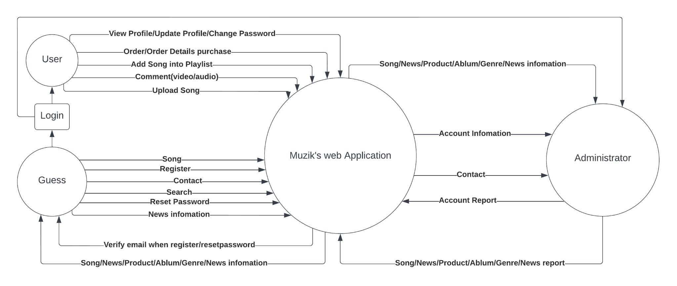
Workflow

Slide 5
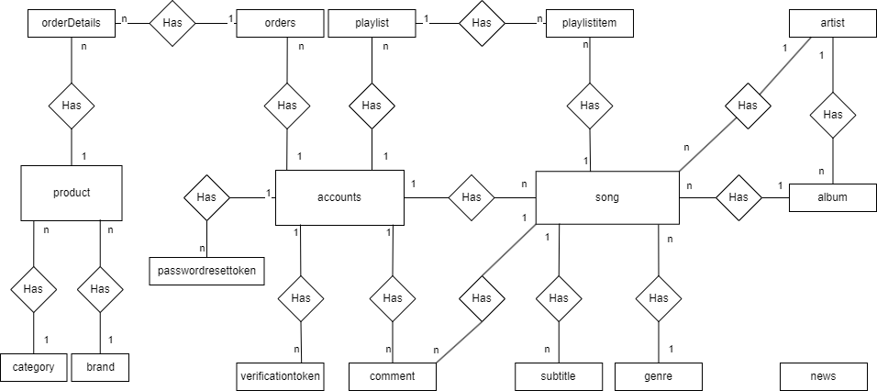
Logical Entity Relationship Diagram

Slide 6
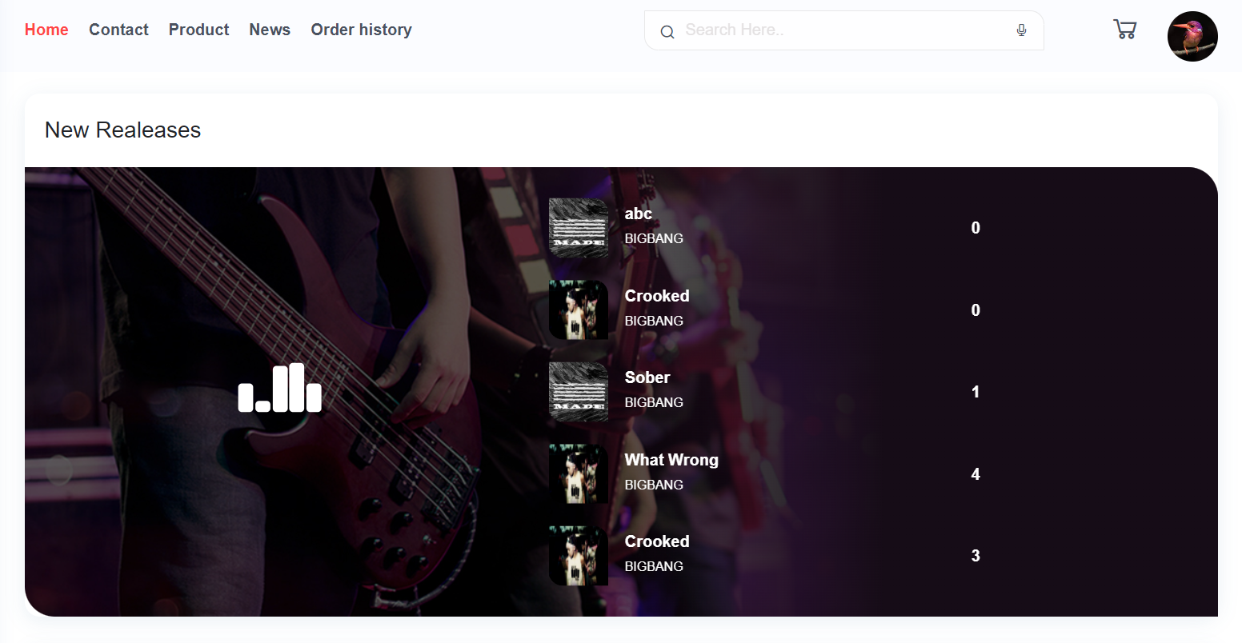
App design

Slide 7
Task sheet Project
Music Web
Task | Status | Owner | Start Date | Due Date
Acount, Promotion, Security, Register/Login, Login Fb Google, Forget/Reset Password, Verify Email(reset-password/register), Upgrade VIP, Login/Register/ResetPassword(Andorid) | Completed | Thanh Sang | 7/25/2022 | 8/25/2022
Song(audio-video-lyric-sub),Genre,Album, Artist, Play-Comment-Dowload-Buy(cart Song-order Song) Song, Song/Genre/Artist/Album/SearchSong(Android) | Completed | Duc Nam | 7/25/2022 | 8/25/2022
Product, Category, Brand, Playlist, User's Personal Music (Upload Songs) | Completed | Huy Hoang | 7/25/2022 | 8/25/2022
News, cart product, order product | Completed | Duc Dung | 7/25/2022 | 8/25/2022

